Slide 1
lkkjjlk
Technology,Organization and Management
- Concept of Technology
- Approaches to Technology and Organization
- Social Networking
- Use of Technology in People Management
Santosh Bhandari
Nayan Pathak
Roshan Bhandari

Slide 2
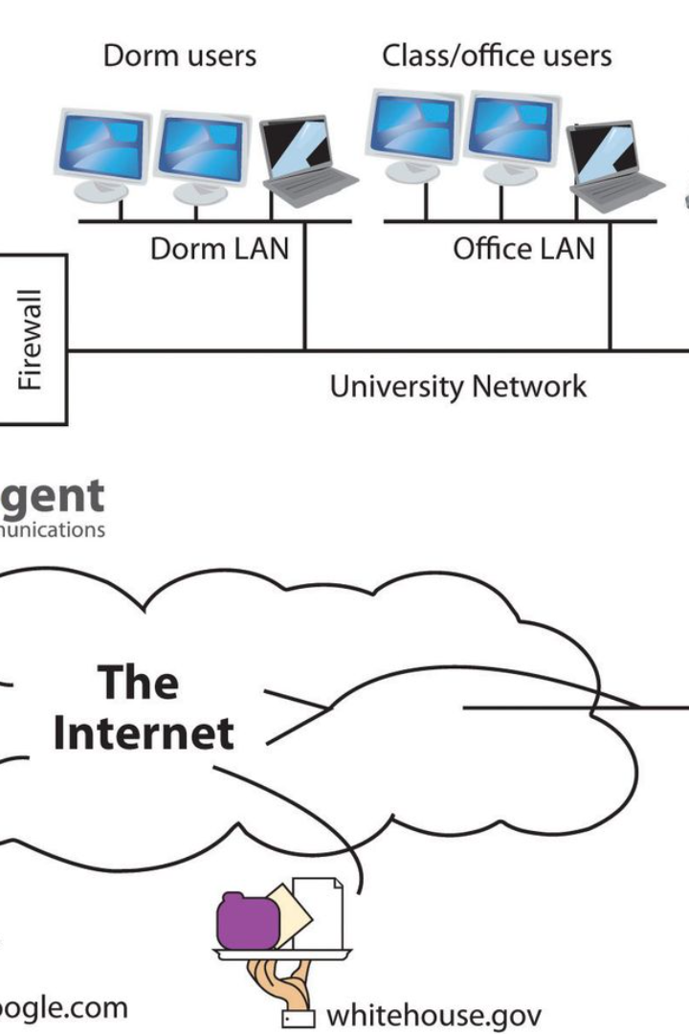
Technology and it's Approaches
By Santosh Bhandari

Slide 3
What is Technology?
Technology plays a crucial role in fueling efficiency and connecting people across the globe. It's the driving force behind productivity, innovation, and the advancement of organizations.
It is the advancement in ways or principles of doing things to ensure better productivity and profitability.
1
Applying Scientific Knowledge
2
Tools and Processes
3
Examples
The use of tools and processes to simplify life and enhance efficiency.
Illustrated by computers, communication devices, and medical equipment.
Utilizing scientific principles for practical purposes.

Slide 4
Technology and Organizations
Technology's Influence
Organizational Impact
Examples
Impacting organizational structure, work processes, and decision-making.
Adapting to and steering technology development and usage.
Manifested through automation, data analytics, and remote work platforms.

Slide 5
Different Approaches to Technology in Organizations
Uncertainty and Predictability
Technology as a System
Stability and Change
Analyzing technology as a whole and considering its components and interactions.
The role of technology in driving change or maintaining stability within organizations.
Technology's impact on the predictability or uncertainty in organizational environments.

Slide 6




The Future of Technology and Organizations
AI and Automation
Increased automation may lead to job displacement and ethical concerns.
Remote Work and Digital Divide
New work models bring the risk of inequalities and isolation.
The Human Touch
Striking a balance between technology and human values, well-being, and collaboration.

Slide 7
Thank You

